Slide 1

To the Moon
Predicting the Price of BTC Using Time Series Models

Slide 2
Motivation
Bitcoin has a market cap of $1.08 trillion
If it were a stock, it would be the 7th largest globally
The price of Bitcoin is highly volatile
The 30-day implied volatility is 101.66
The same index of S&P 500 is 13.74
Most algorithmic trading strategies take profit from volatility
Higher volatility -> more profit
Direction of price movement is irrelevant as long as we can predict the price with high enough accuracy

Slide 3
Data
Two years of hourly data pulled using an API provided by Crypto Compare
Trade data includes open price, close price, highest price, lowest price and volume traded for each hour
Data also includes engagement on Reddit, Crypto Compare, and BTC code repo
We will model primarily using trade data and we will explore if engagement data helps prediction

Slide 4
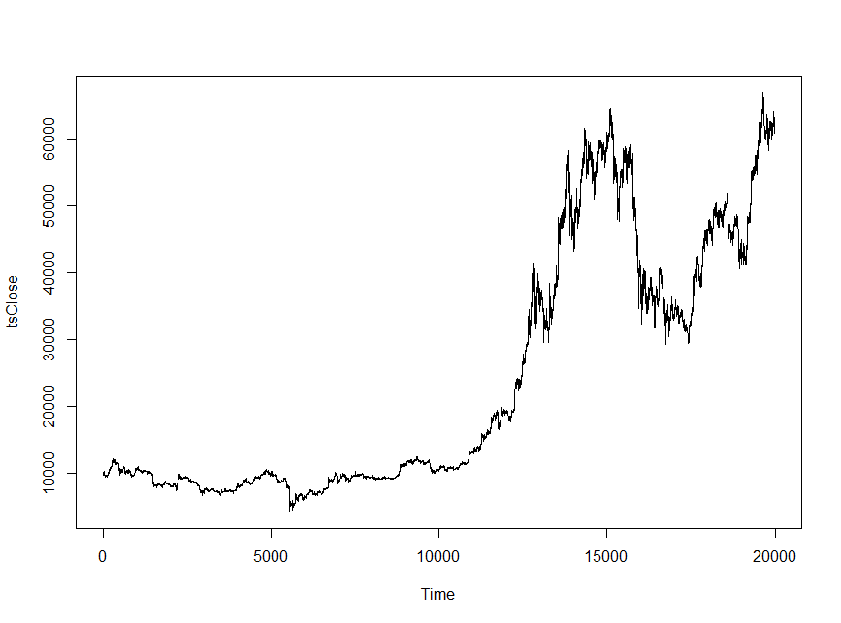
EDA Stationarity
Plot of BTC Hourly Close Price
Raw price is not stationary
The Augmented Dickey-Fuller Test and the KPSS test both claim that price is not stationary
Solution: Transform price to hourly returns

Slide 5
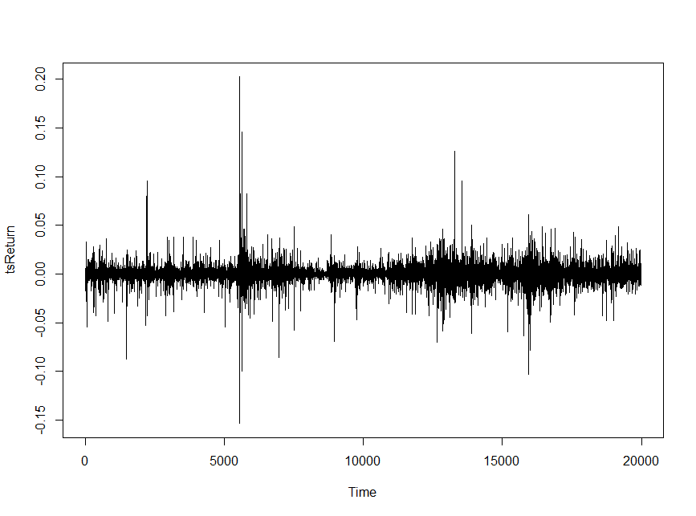

EDA Stationarity
Plot of BTC Hourly % Return
Return is defined as % return each hour
$$return=\frac{\left(close −open\right)}{open}$$
Return is stationary, confirmed by ADF and KPSS tests

Slide 6
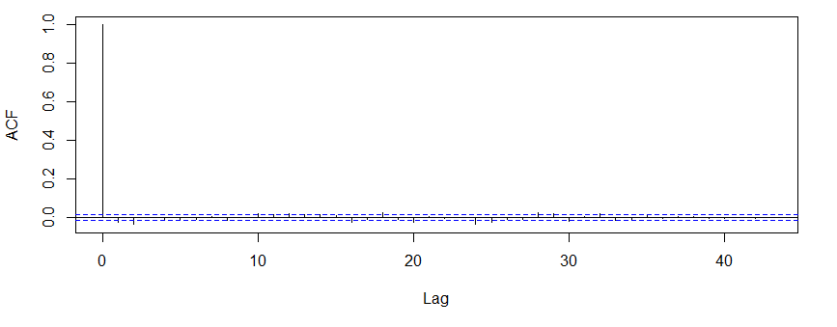
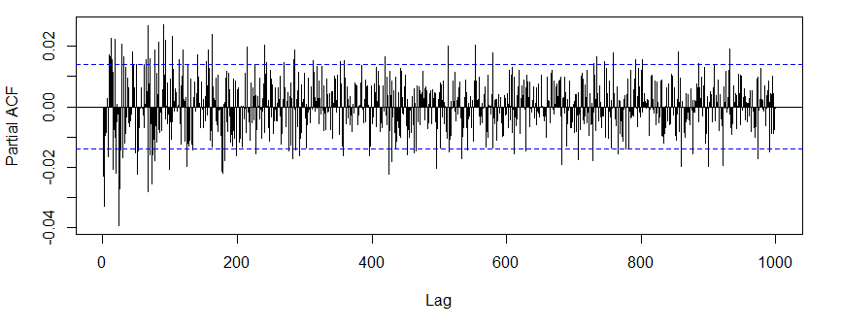
EDA Seasonality
Autocorrelation of % Return
The partial autocorrelation suggests that we may need hundreds of lags
This is unrealistic
% return may suffer from seasonality
Possible solution: Transform data to account for seasonality
Partial Autocorrelation of % Return

Slide 7
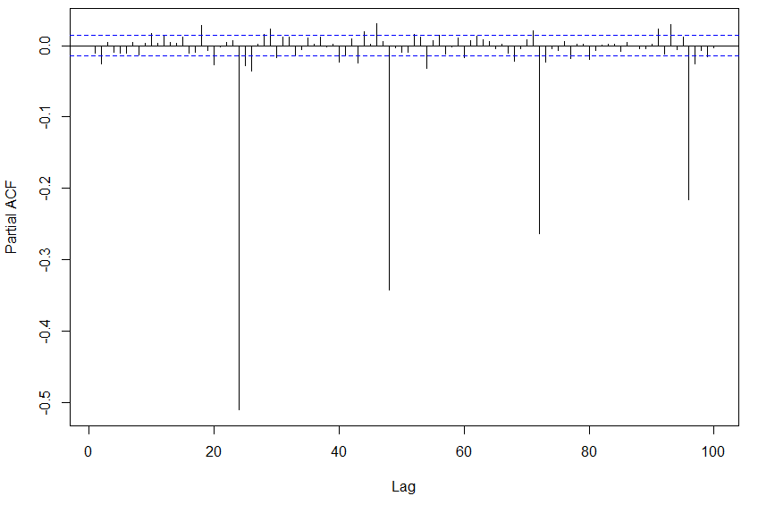

EDA Seasonality
Partial Autocorrelation of Absolute Return Adjusted for 24-Hour Seasonality
To adjust for “seasonal” effects every 24 hours, we calculated 24-hour price movements
$$return= \\ close price vs 24 hours ago −open price vs 24 hours ago$$
Looks like this adjustment didn’t help much and created stronger seasonal effects
We’ll revert back to % return for now

Slide 8
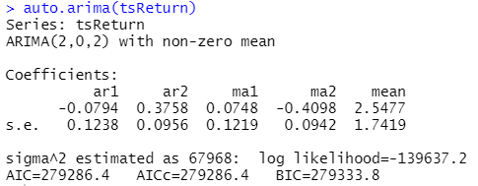
Model % return only
Used auto.arima to automatically find lags for AR and MA
Model chose AR(2), MA(2)

Slide 9
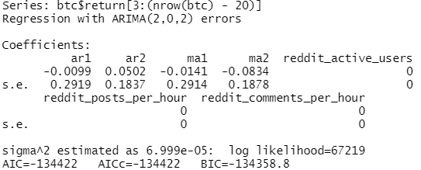
Model Dynamic Regression
What happens if we add in reddit engagement of BTC from the previous hour?
The model still chose AR(2), MA(2)
Based on BIC, this model seems to fit much better though
BIC of the previous model: 279333.8

Slide 10
Next Steps
Seasonality
We haven’t fixed the seasonality issue yet
The current model uses % return, which the PACF plot has shown that hundreds of lags may relevant
Additional Predictors
We have only modelled on % return and reddit engagement from the day before
Some widely-used technical predictors may be helpful (e.g. 12-period EMA, RSI)
Validation
We may need to write our own validation code
We are really interested in predicting price at the next hour only
To reliably calculate an accuracy score, we should predict prices at dozens of hours
Need a method to use the actual price rather than the predicted price at time t+1 to predict the price at time t+2

Slide 11

haven’t arrived at the Moon yet but we’ll get there

